Slide 1
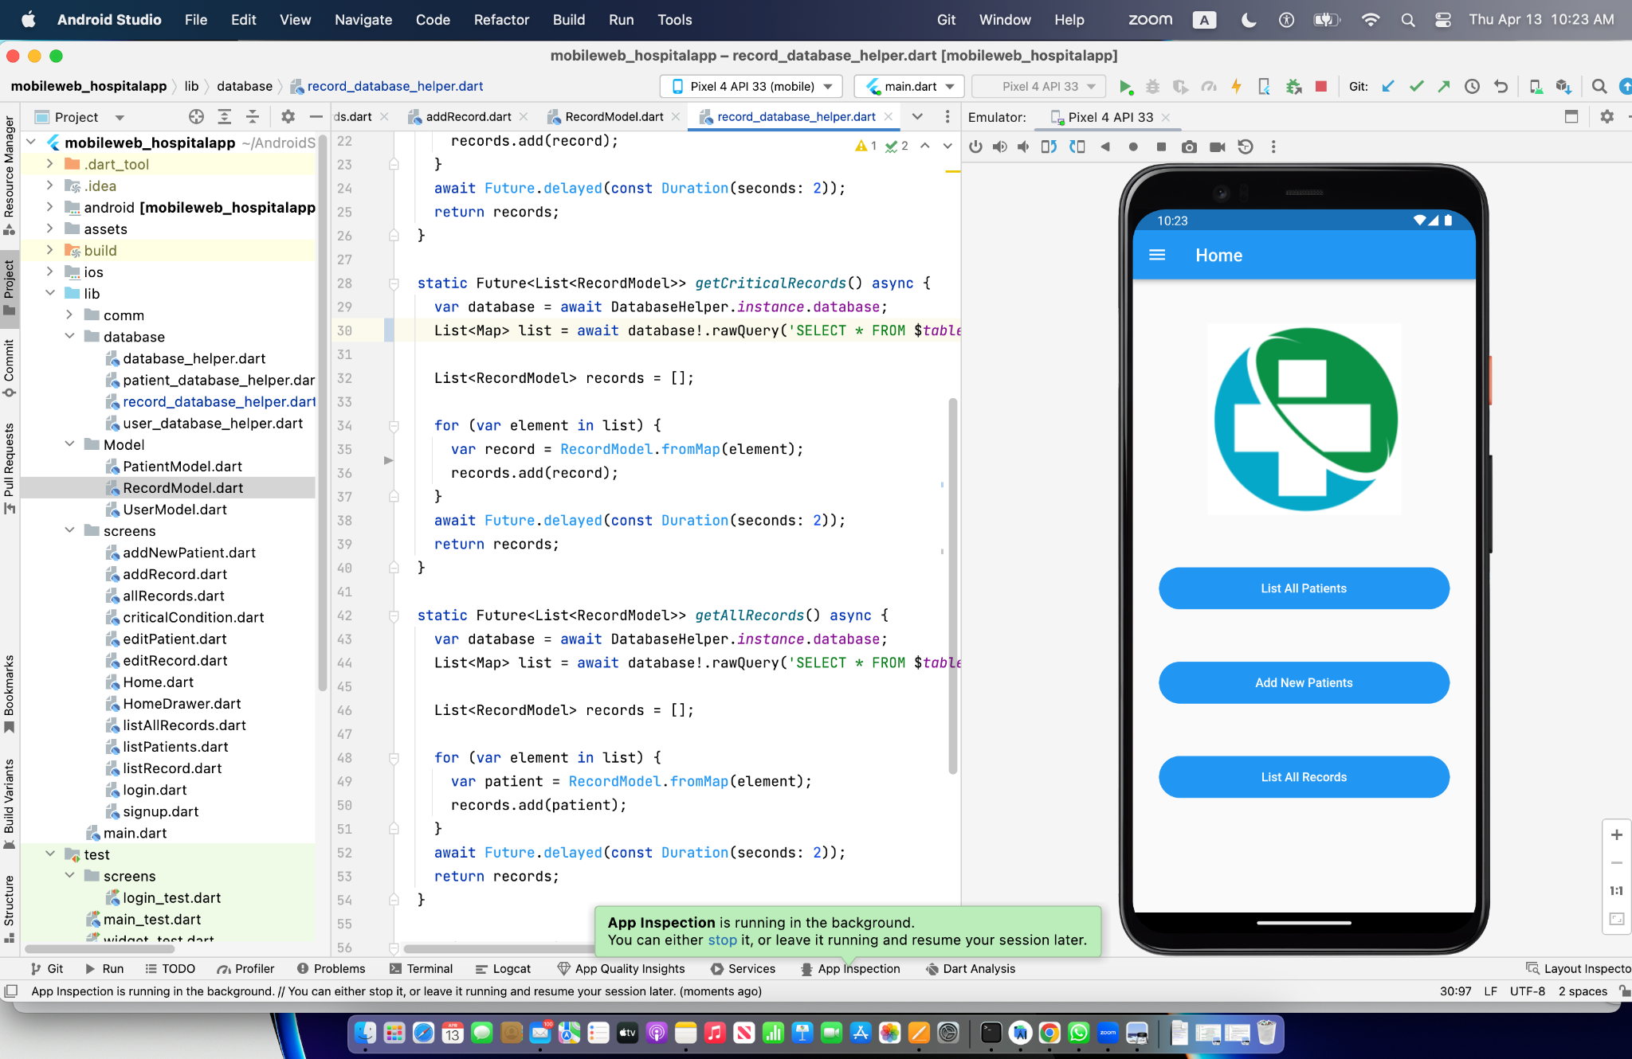
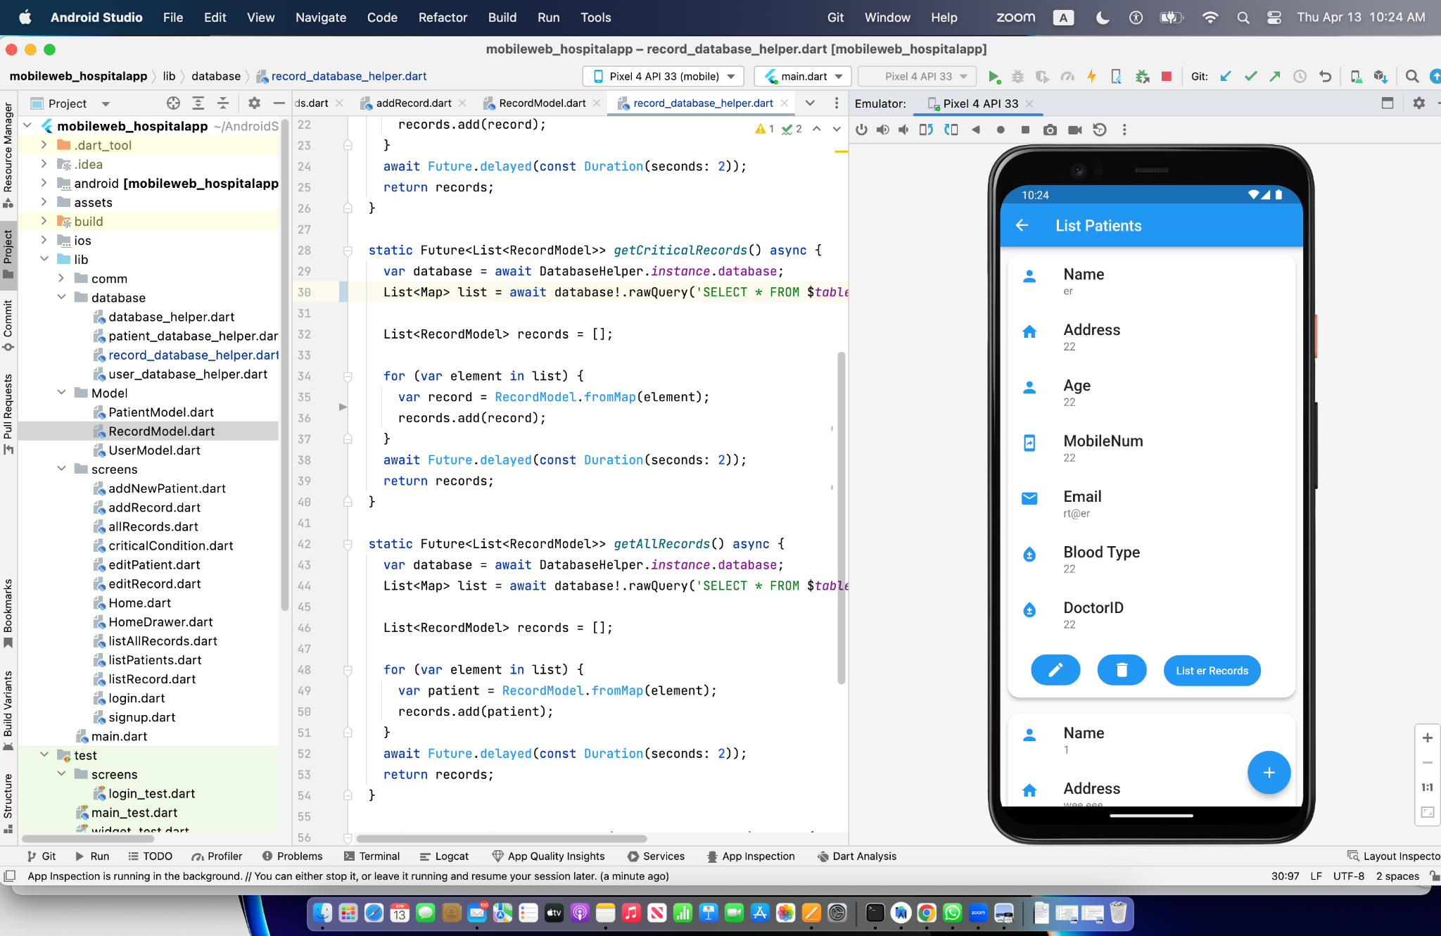
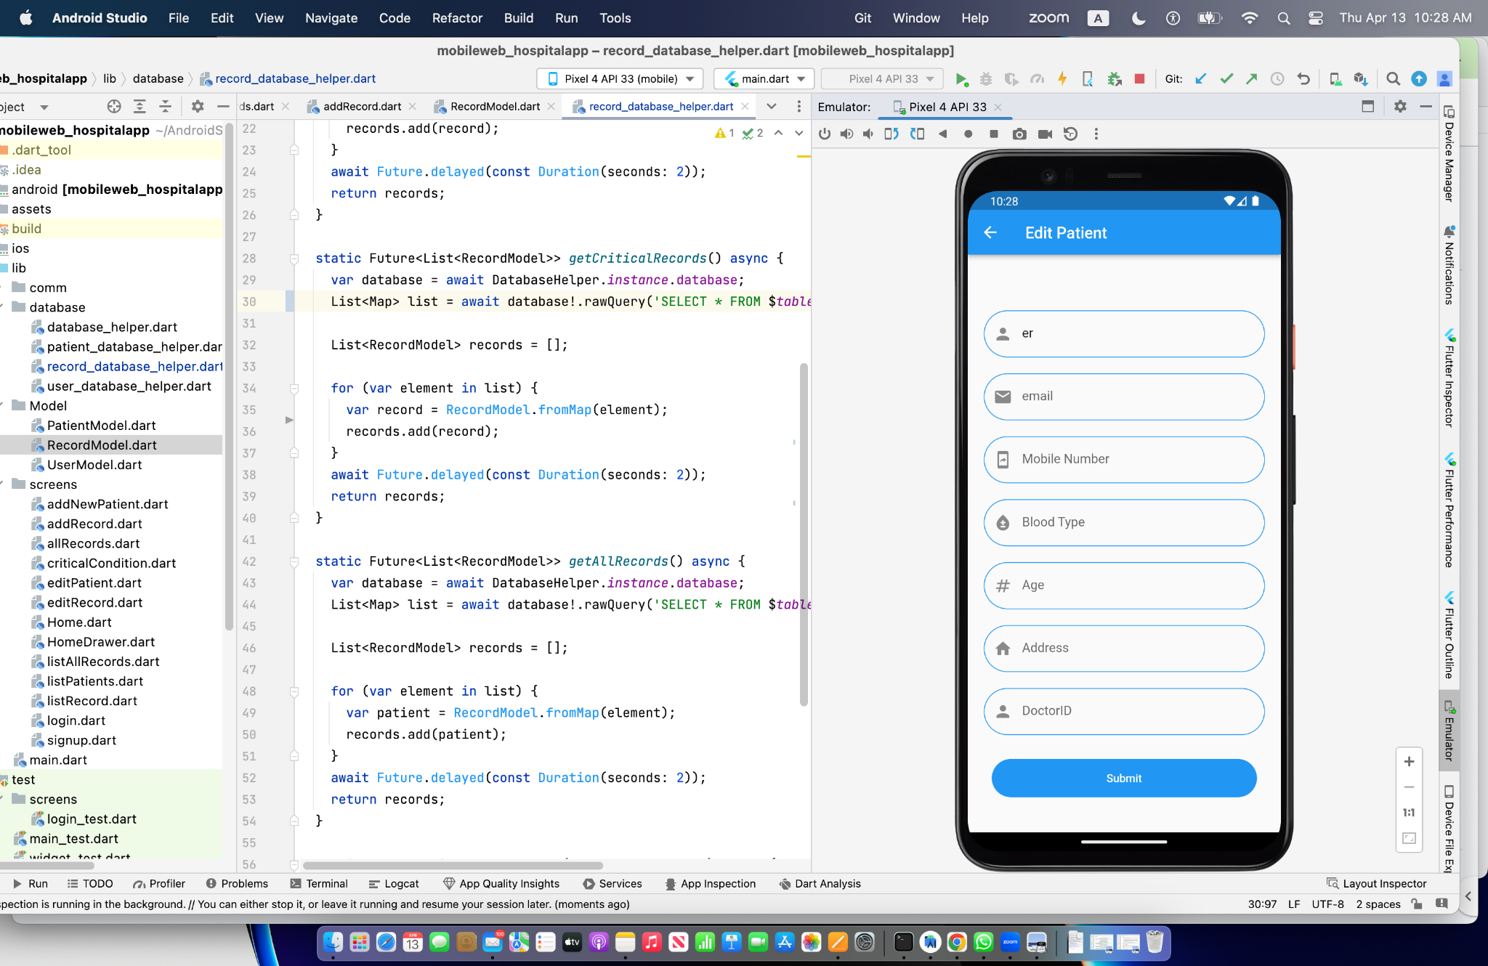
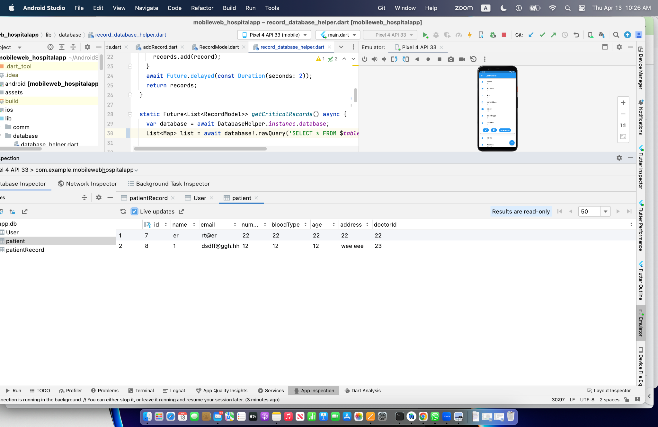
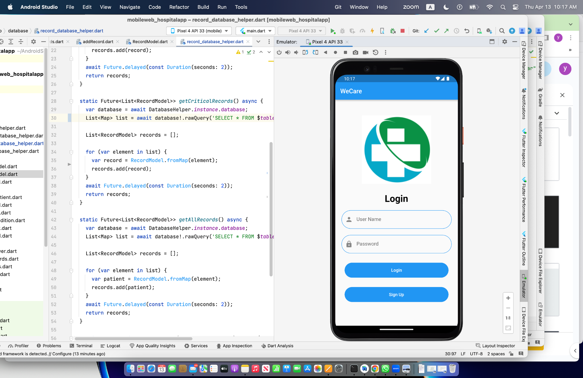
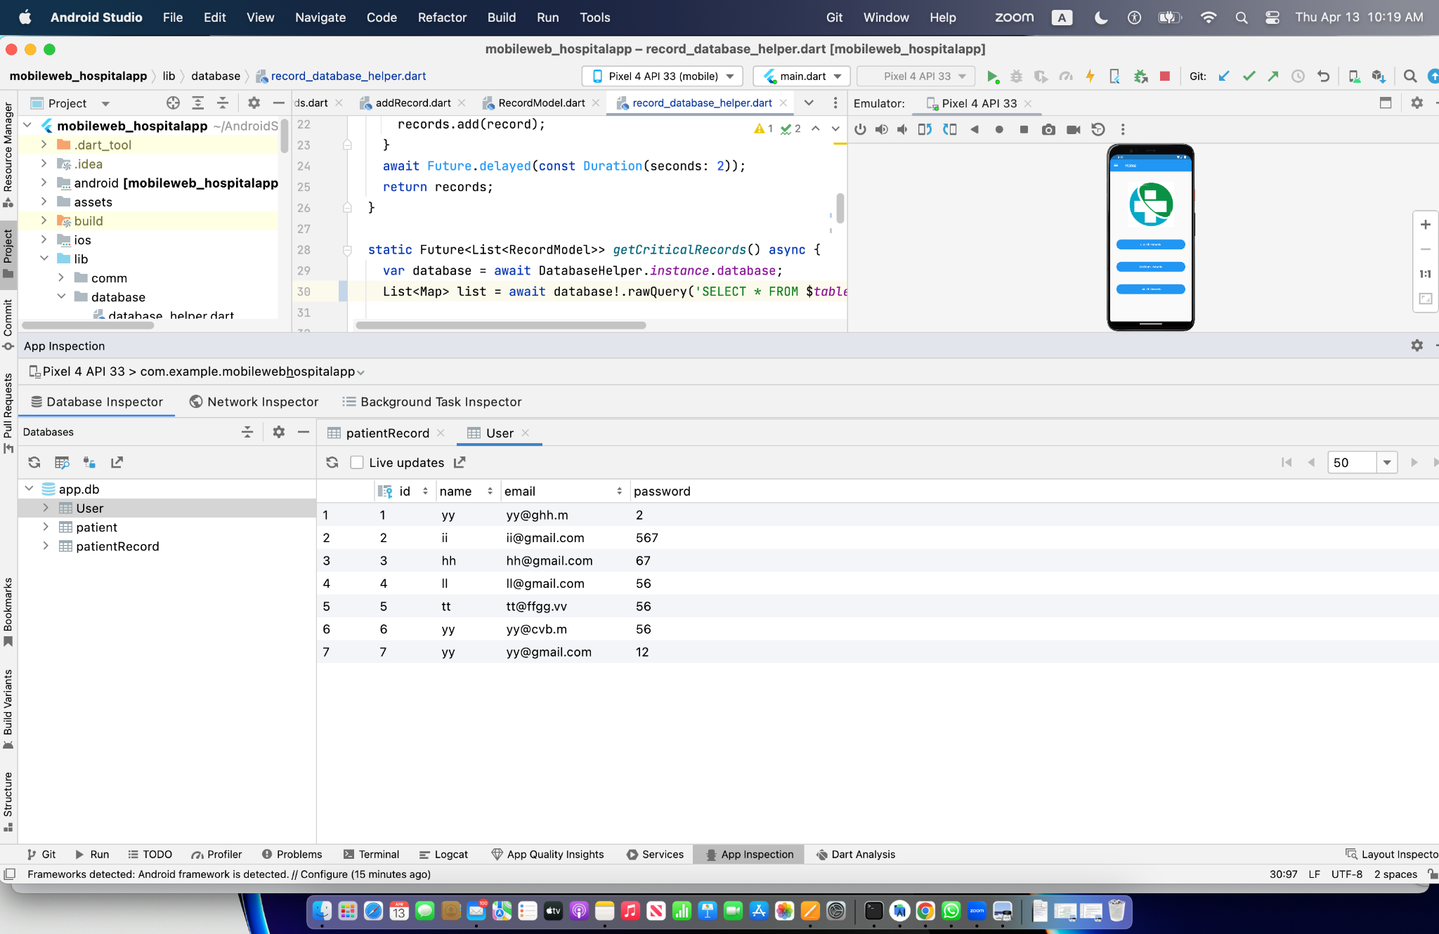
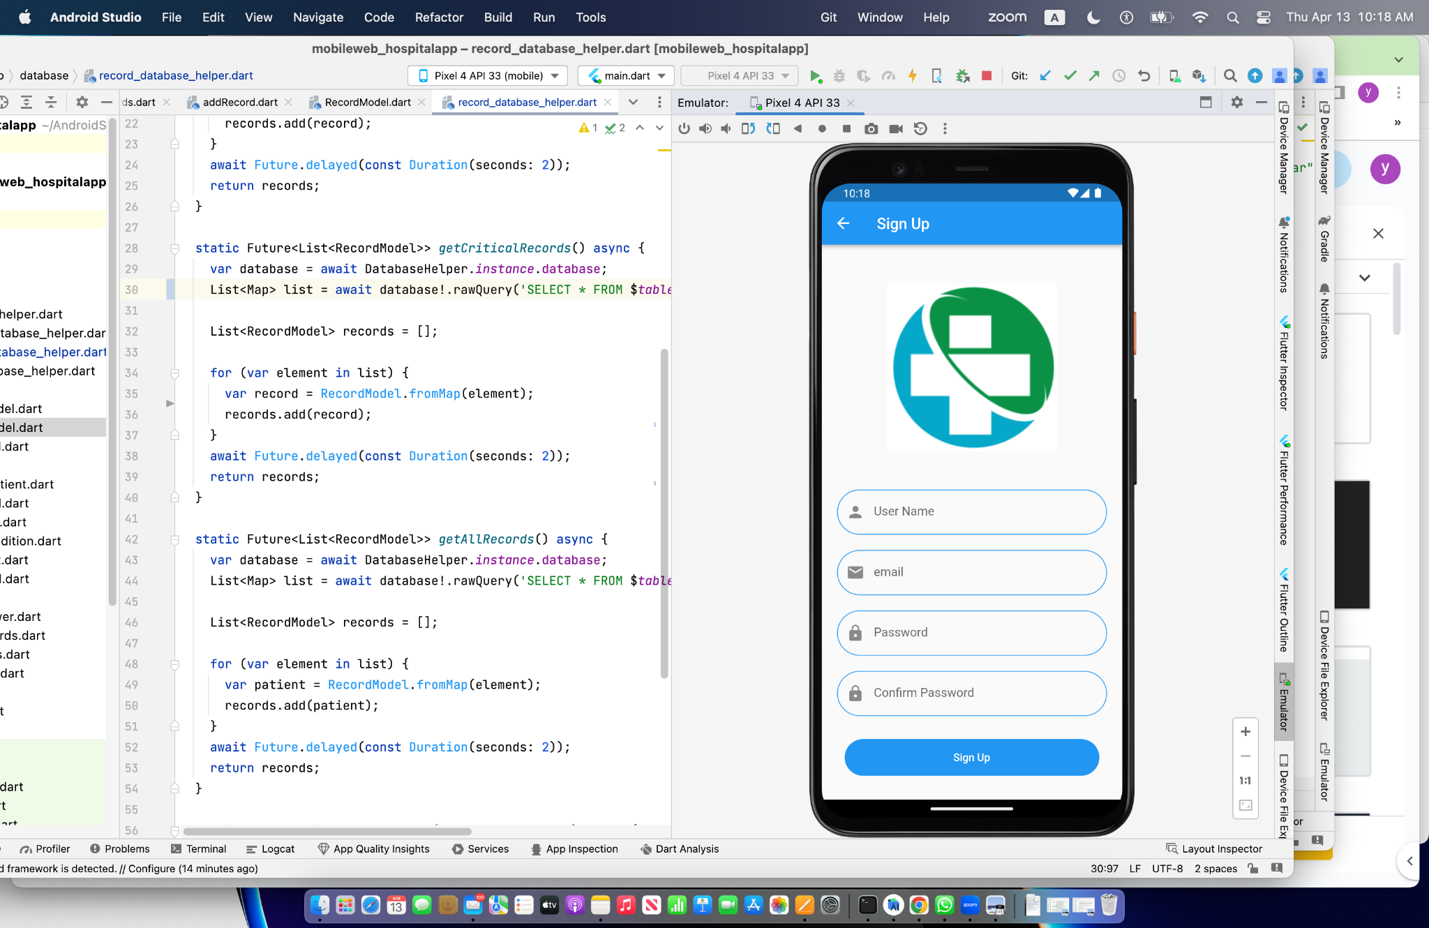
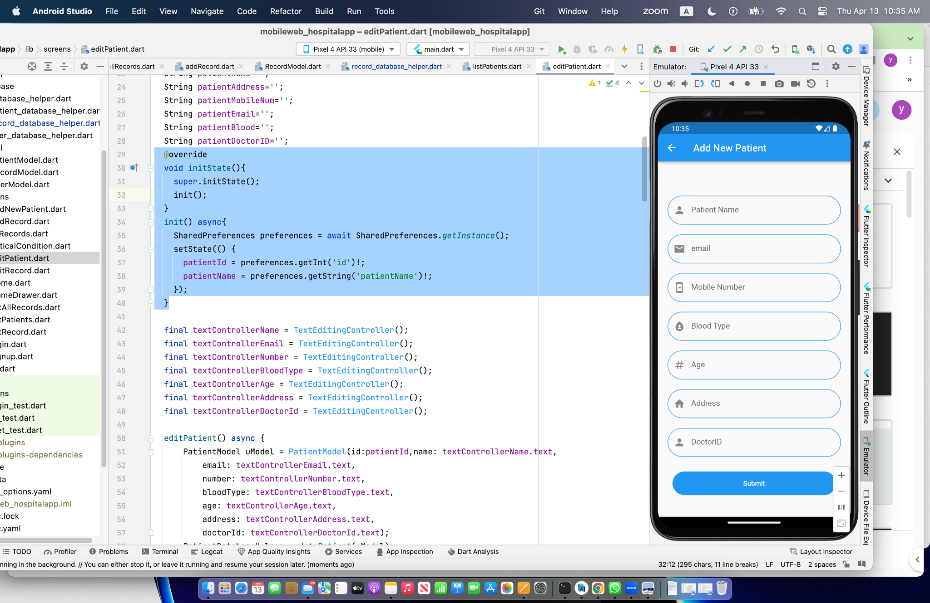
onPressed: () async {
//listPatient();
int? selectId=user.id;
SharedPreferences preferences= await SharedPreferences.getInstance();
preferences.setInt('id',selectId!);
preferences.setString('patientName', user.name.toString());
listPatient();
},
@override
void initState(){
super.initState();
init();
}
init() async{
SharedPreferences preferences = await SharedPreferences.getInstance();
setState(() {
patientId = preferences.getInt('id')!;
patientName = preferences.getString('patientName')!;
});
}

Slide 2
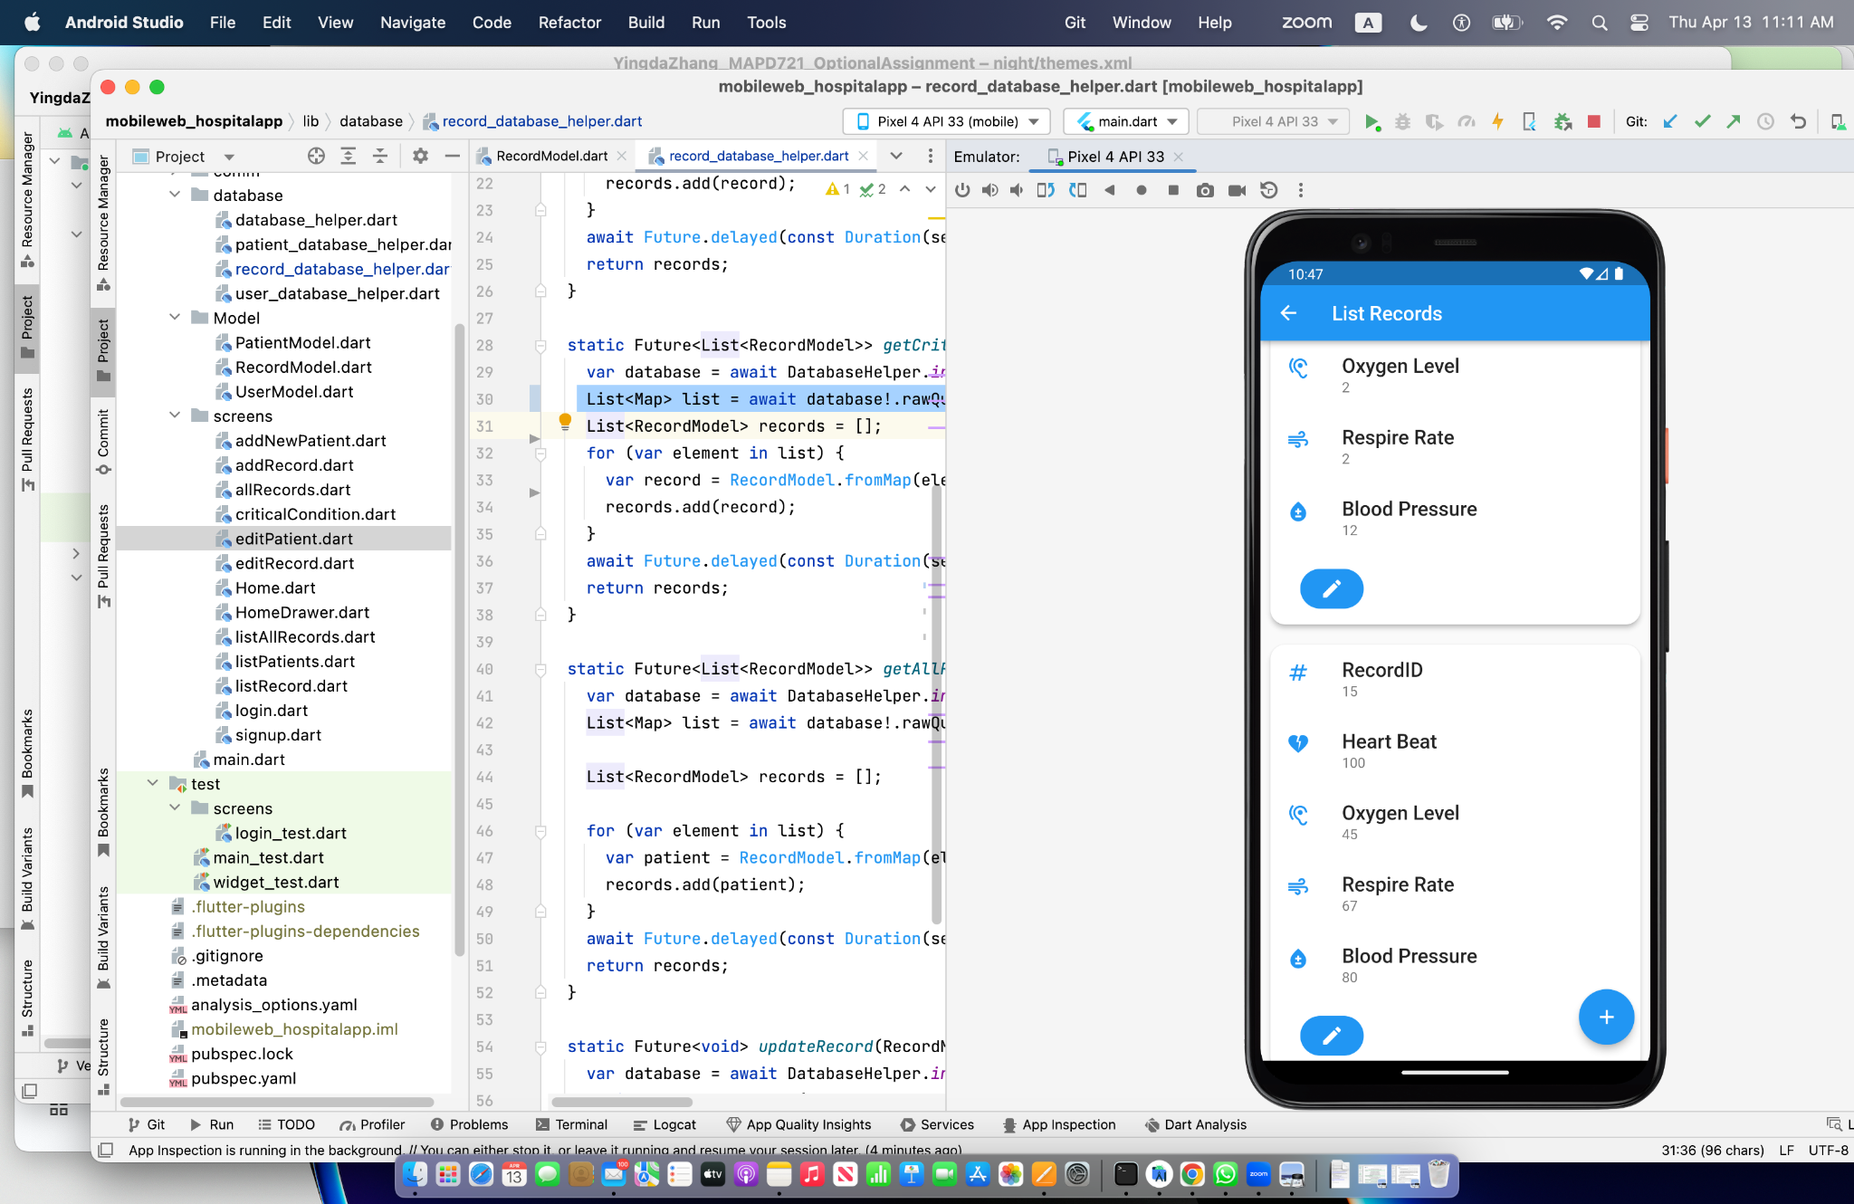
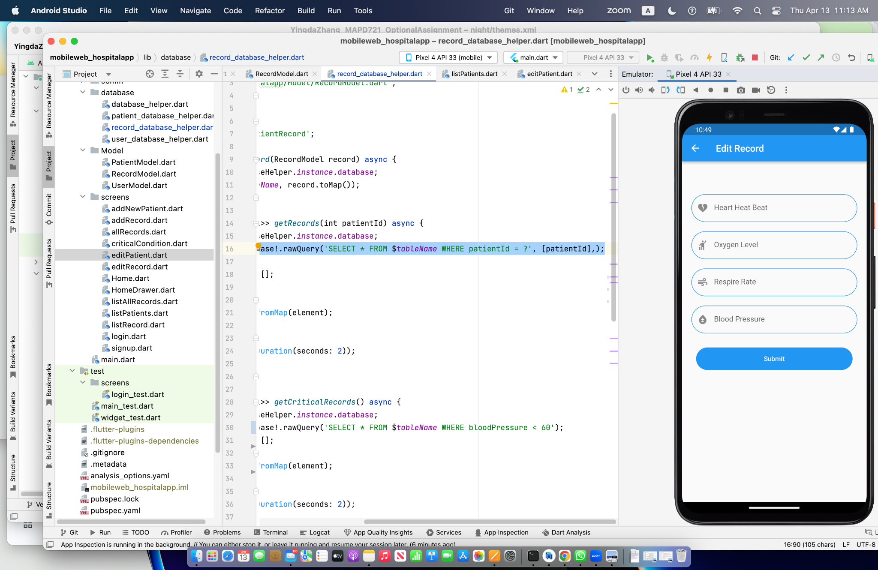
List<Map> list = await database!.rawQuery('SELECT * FROM $tableName WHERE patientId = ?', [patientId],);
var database = await DatabaseHelper.instance.database;
await database!.update(tableName, record.toMap(), where: 'recordId = ?', whereArgs: [record.recordId],);

Slide 3
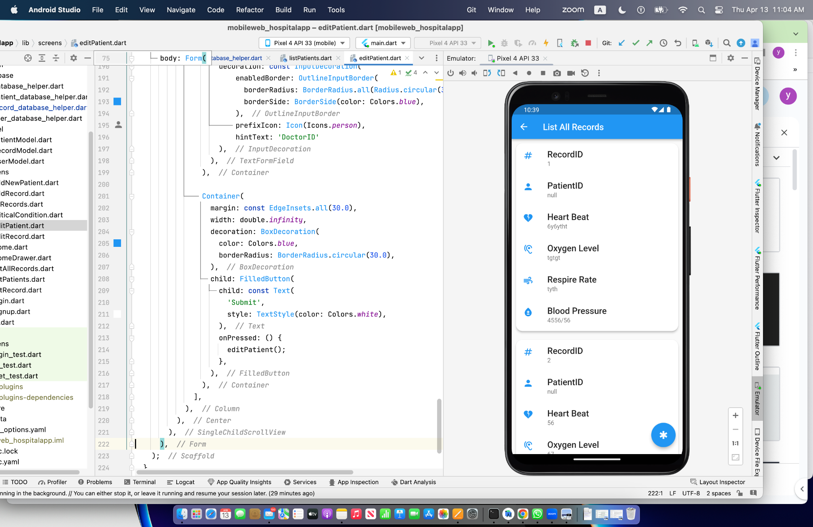
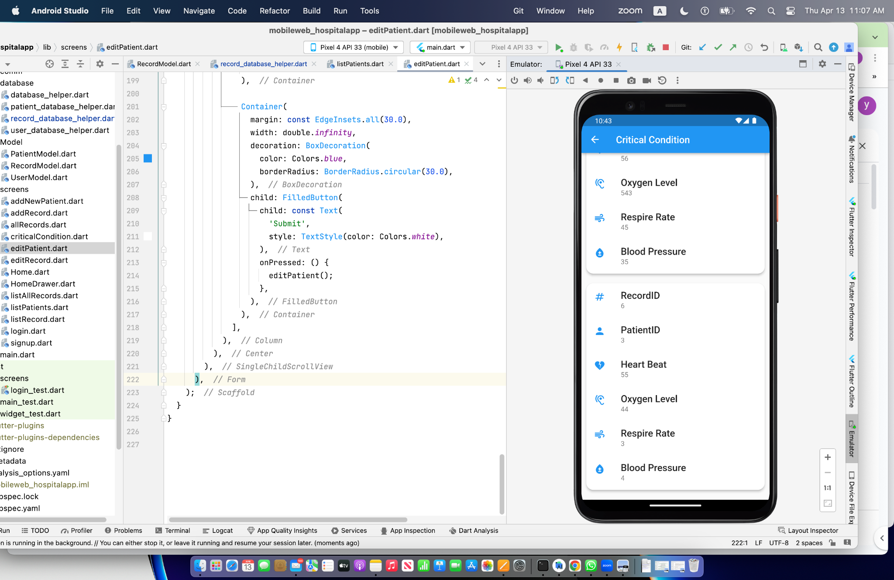
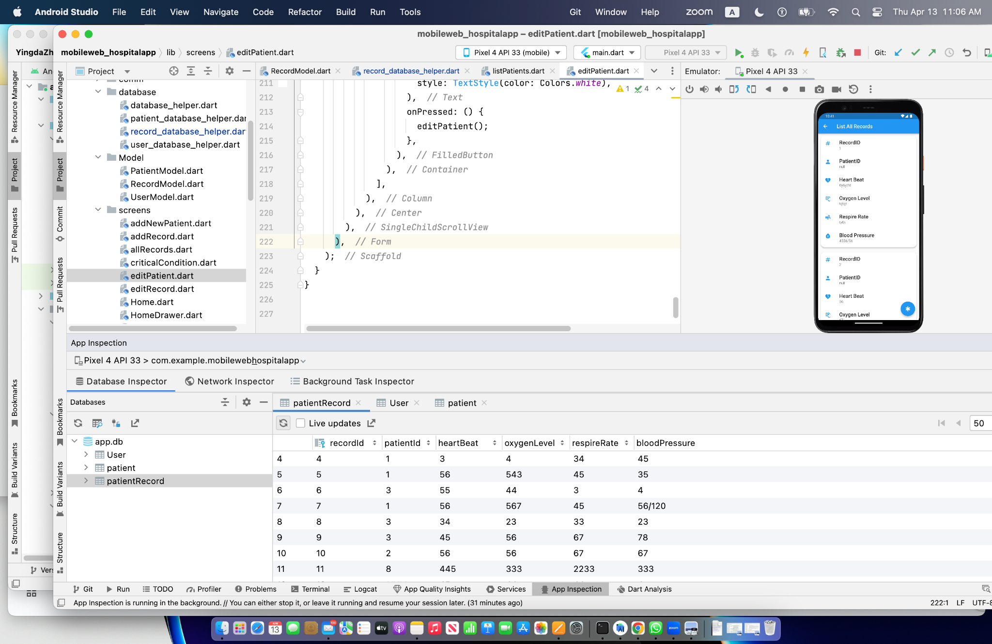
List<Map> list = await database!.rawQuery('SELECT * FROM $tableName WHERE bloodPressure < 60');

